Slide 1
AMiON Text Page & Logout

Slide 2
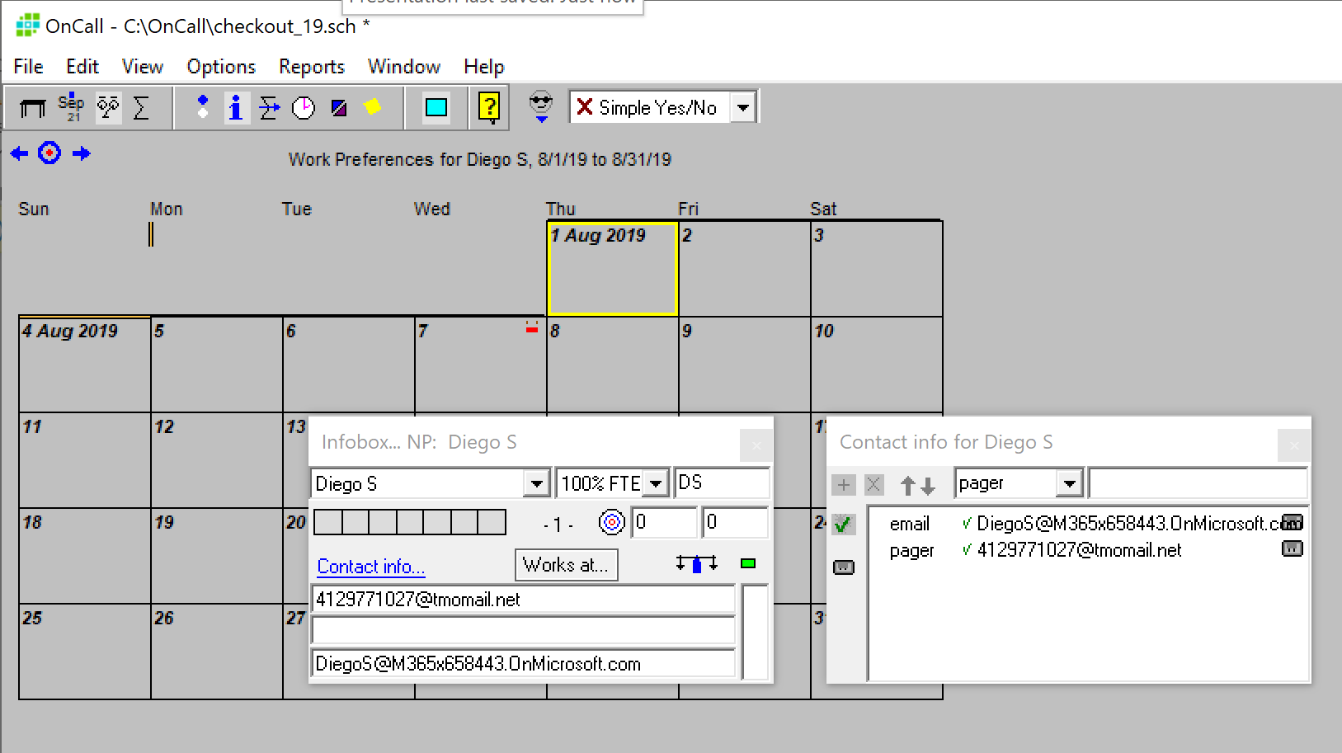
Setup of Text Page in AMiON

Slide 3
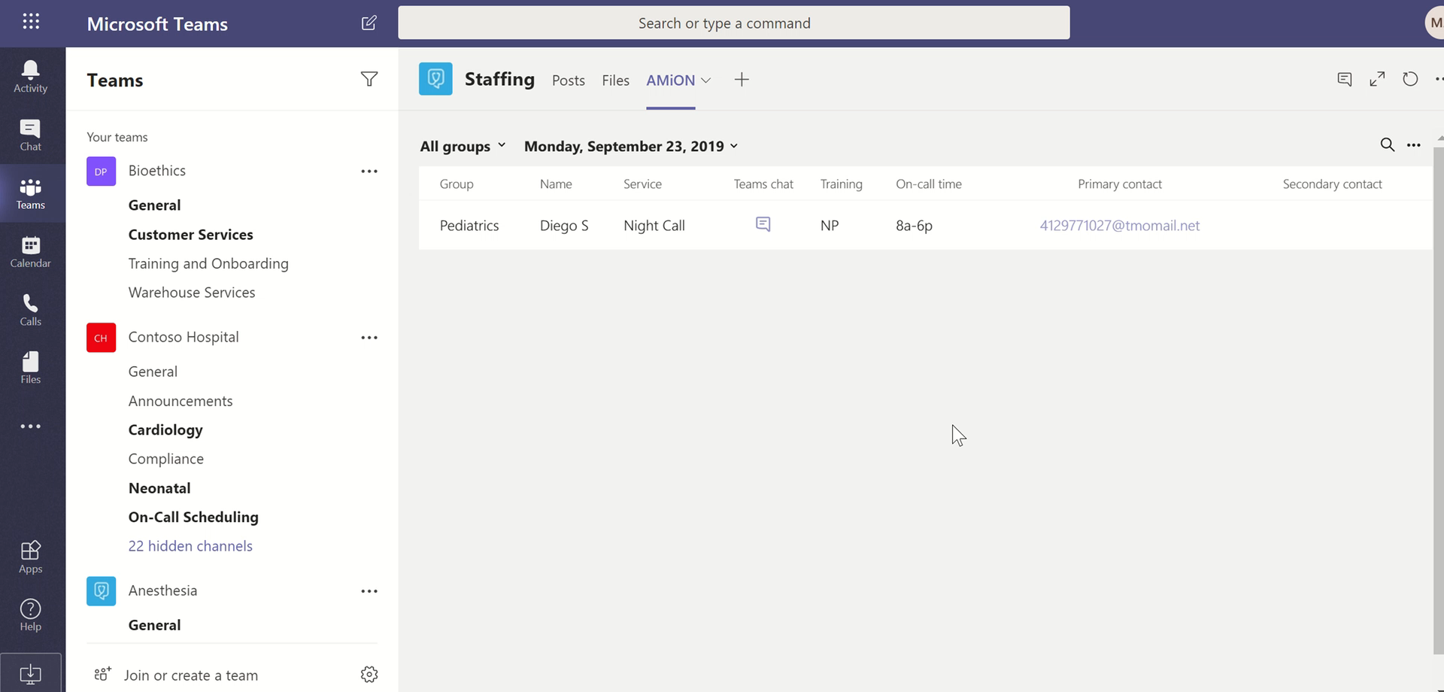
Video – Sending Text Page

Slide 4
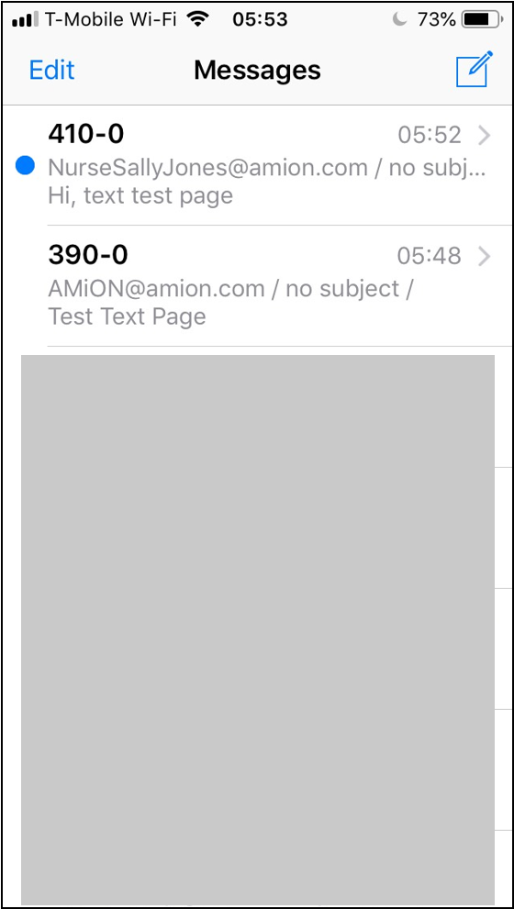
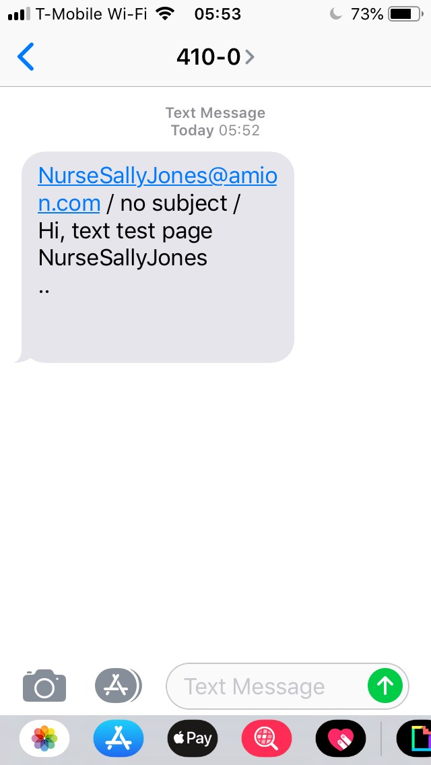
Receipt of Text Page

Slide 5
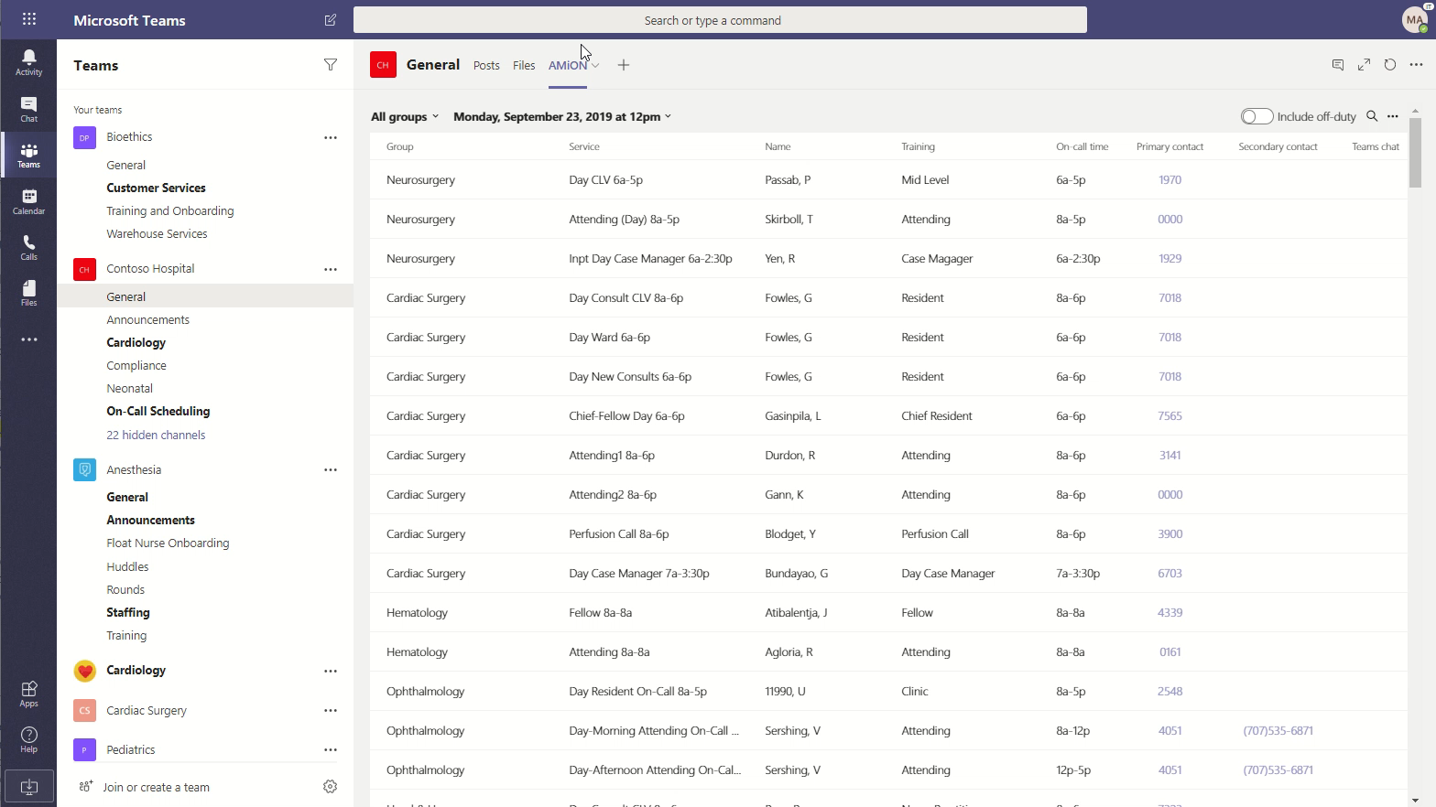
Video – Logout

